Slide 1
Binary Logistic Regression
1

Slide 2
Binary Logistic Regression
Binary Logistic Regression is used when dependent variable is
‘binary’(=zero or one, presence or absence, death or survival)
The independent variables can be categorical or continuous.
Wide range of application areas:
Marketing Analytics (Cross Sell/Up sell)
Churn Management (Customer Churn, Employee Churn)
Risk Management (Credit Scoring, Fraud Detection)
Market Research
Clinical Research

Slide 3
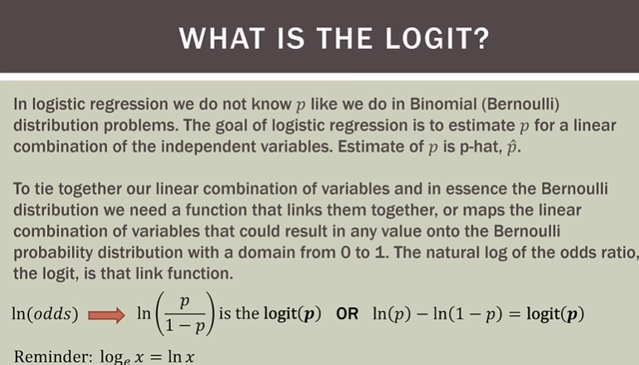

Slide 4
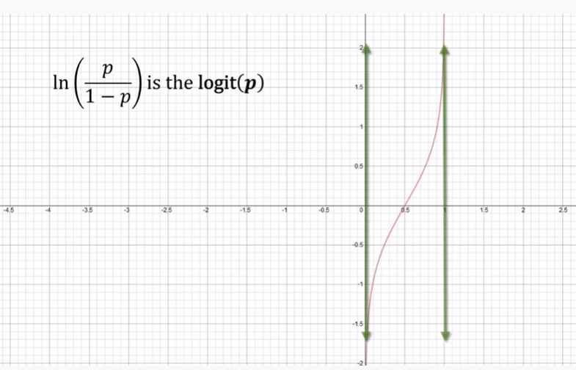

Slide 5
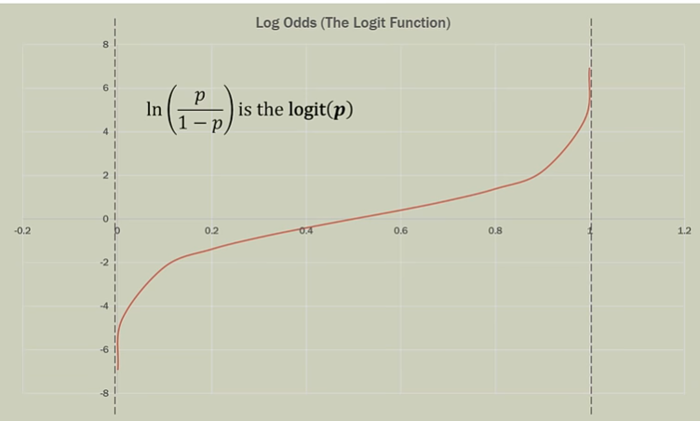

Slide 6
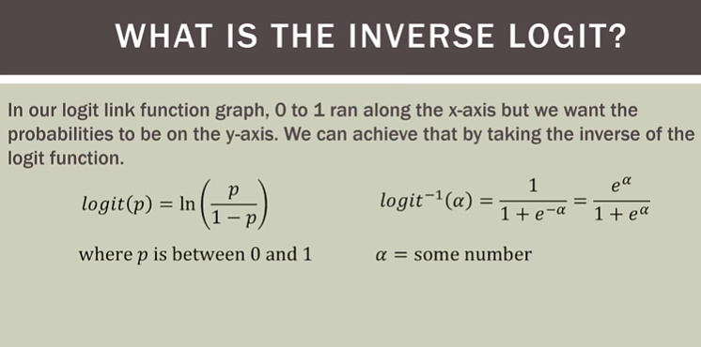

Slide 7
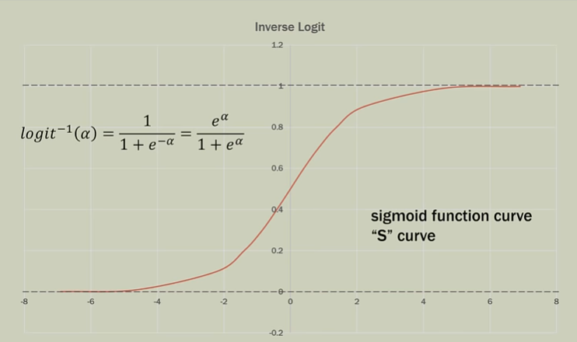

Slide 8
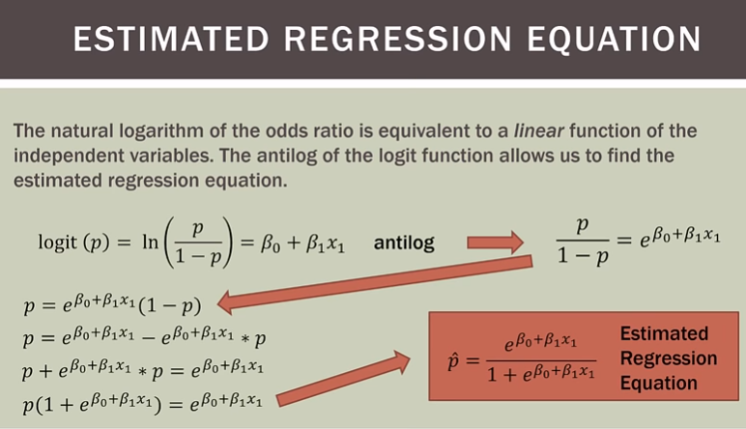

Slide 9
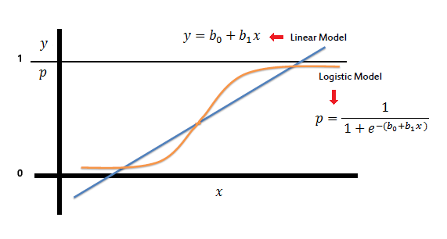
Why not use linear regression model?
Multiple Linear Regression Y=b₀ + b₁x₁ + b₂x₂ + - - - - + b_{p}x_{p} + e
If binary variable Y is used on left hand side of the model, then the two sides are not comparable. Right hand side is a continuous term.
If probability ‘P’ is used instead of Y then linearity may not hold true. The relationship assumed in logistic regression is a ‘S’ shaped curve.

Slide 10

Statistical Model in Binary Logistic Regression K Predictors
Let Y be the binary dependent variable and X₁ ,X₂,…X_{k} are K
Independent variables.
log
= b₀ + b₁X₁ + b₂X₂ + - - - + b_{k}X_{k}
Note that LHS of the
p
Y
X₁ ,…, X_{k}
: Probability that Y=1
: Dependent Variable
: Independent Variables
Model can lie between - ∞ to – ∞
b ₀, b ₁ ,…, b _{k} : Parameters of Model
Parameters of the model are estimated by Maximum Likelihood Estimation(MLE) Method.
10

Slide 11
Statistical Model in Binary Logistic Regression
K Predictors…..
log
= b₀ + b₁X₁ + b₂X₂ + - - - + b_{k}X_{k}
Note that Y takes only two values:0 or 1. Therefore, Y can not be used on LHS.
P lies between 0 and 1.
P/(1-p) lies between 0 to infinity.
log [p/(1-p)] lies between –infinity to + infinity.
11

Slide 12





Statistical Model in Binary Logistic Regression Alternative Mathematical Form
Here p is Pr[ Y=1/x] and X is independent variable.
P =
1 – P =
1 –
Similar to linear regression except left Hand side term. Instead of Y, link function Is used.
log
12

Slide 13
Case Study: Predicting Defaulters
Objective : To predict whether the customer applying for the loan will be a defaulter.
Predictors: Age group, Years at current address, Years at current employer, Debt to Income Ratio, Credit Card Debts, Other Debts.
The information on predictors was collected at the time of loan application process.
Dependent Variable: Defaulter (=1 if defaulter ,0 o.w.)
The status is observed after loan is disbursed.
Sample Size:700

Slide 14


Snapshot of the Data
AGE | EMPLOY | ADDRESS | DEBTINC | CREDDEBT | OTHDEBT | DEFAULTER
3 | 17 | 12 | 9.30 | 11.36 | 5.01 | 1
1 | 10 | 6 | 17.30 | 1.36 | 4.00 | 0
2 | 15 | 14 | 5.50 | 0.86 | 2.17 | 0
3 | 15 | 14 | 2.90 | 2.66 | 0.82 | 0
1 | 2 | 0 | 17.30 | 1.79 | 3.06 | 1
3 | 5 | 5 | 10.20 | 0.39 | 2.16 | 0
2 | 20 | 9 | 30.60 | 3.83 | 16.67 | 0
3 | 12 | 11 | 3.60 | 0.13 | 1.24 | 0
1 | 3 | 4 | 24.40 | 1.36 | 3.28 | 1
2 | 0 | 13 | 19.70 | 2.78 | 2.15 | 0
1 | 0 | 1 | 1.70 | 0.18 | 0.09 | 0
1 | 4 | 0 | 5.20 | 0.25 | 0.94 | 0
Age groups: 1 ( <28 years), 2(28-40 years), 3 (>40 years)

Slide 15
Case Study: Predicting Defaulters …
ADDRESS (-)
DEBTINC (+)
EMPLOY (-)
CREDDEBT (+)
DEFAULTER
(YES OR NO)
OTHDEBT (+)
AGE
log
= b₀ + b₁X₁ + b₂X₂ + - - - + b_{k}X_{k}

